Slide 1
UnscentedKalmanFilter

Slide 2
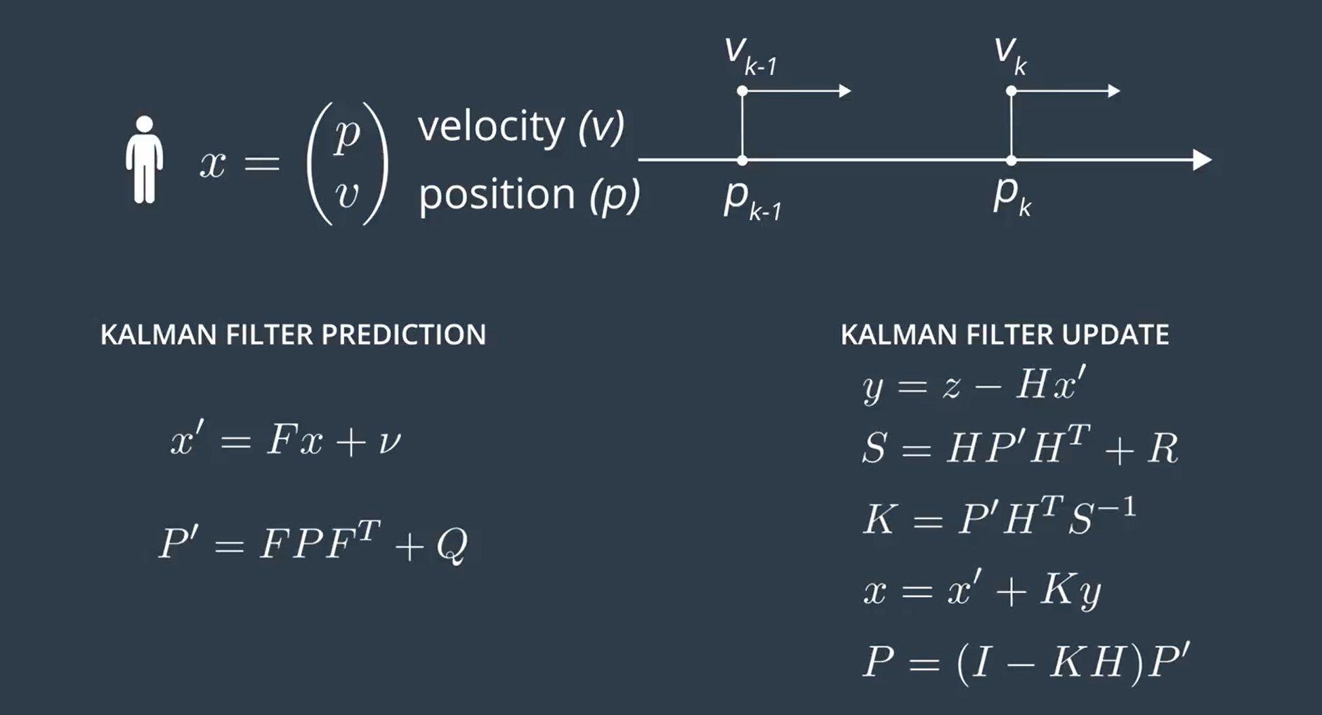

Kalman Filter Equations
Measurement Transformation Matrix
Meas. Vector
State Vector update
state Transformation matrix
Measurement noise Covariance Matrix
Process noise
state Vector
Kalman Gain
Process noise Covariance Matrix
State Covariance Matrix update
State Covariance Matrix

Slide 3
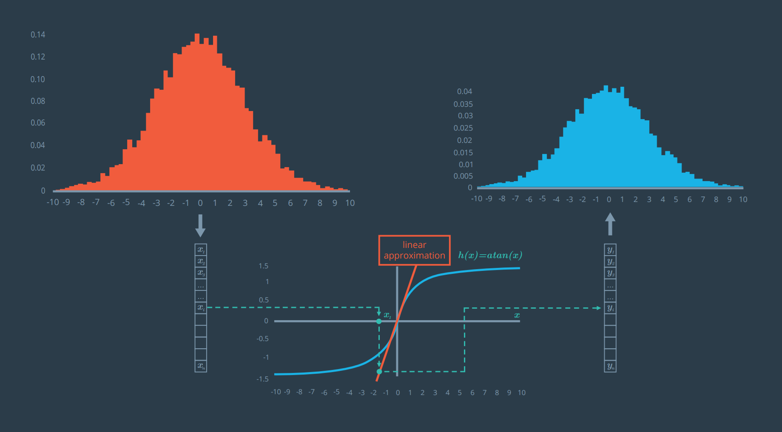
Kalman Filters Flavours
Linear/ordinary KF
Linear state transition equations
Linear measurement transformation equations
Extended Kalman Filter
Linearize nonlinear state transition equations
Linearize nonlinear measurement transformation equations
Unscented Kalman Filter
The unscented Kalman filter, on the other hand, does not need to linearize non-linear functions; instead, the unscented Kalman filter takes representative points from a Gaussian distribution.
These points will be plugged into the non-linear equations as you'll see in the lectures.

Slide 4
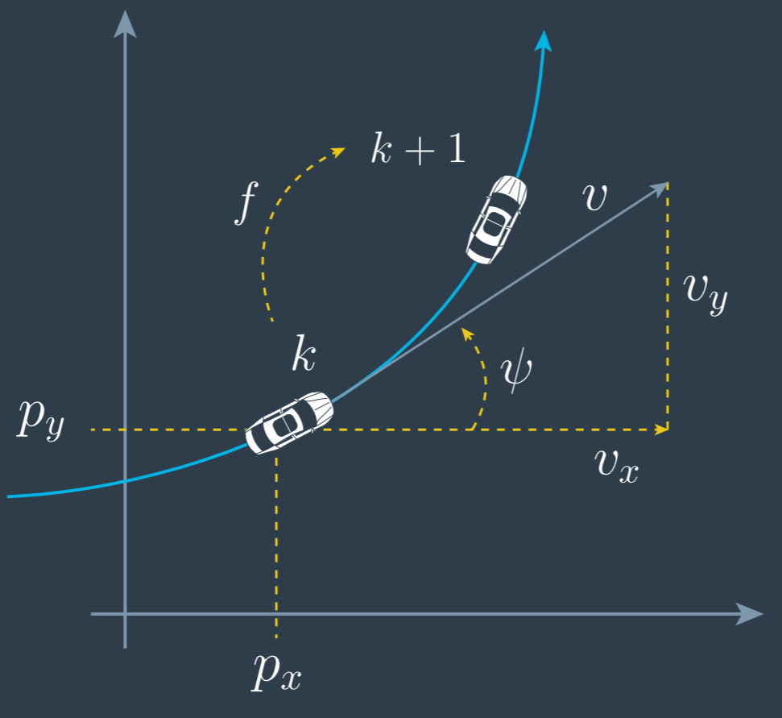
The CTRV Model
Motion Models and Kalman Filters
constant turn rate and velocity magnitude model (CTRV)
constant turn rate and acceleration (CTRA)
constant steering angle and velocity (CSAV)
constant curvature and acceleration (CCA)

Slide 5
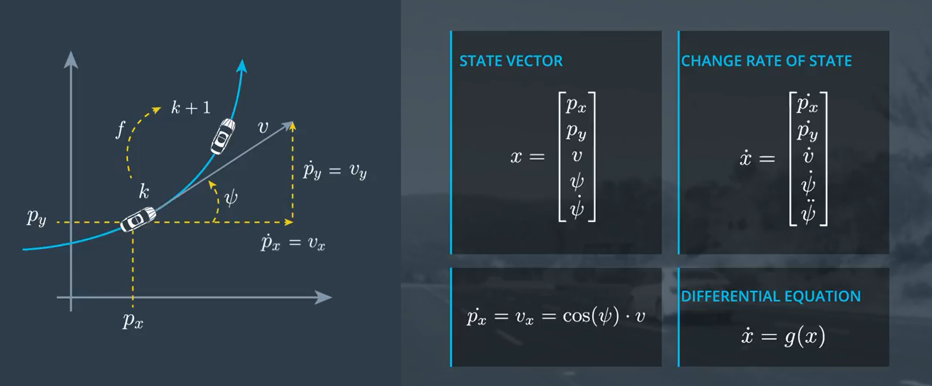
The CTRV Model

Slide 6
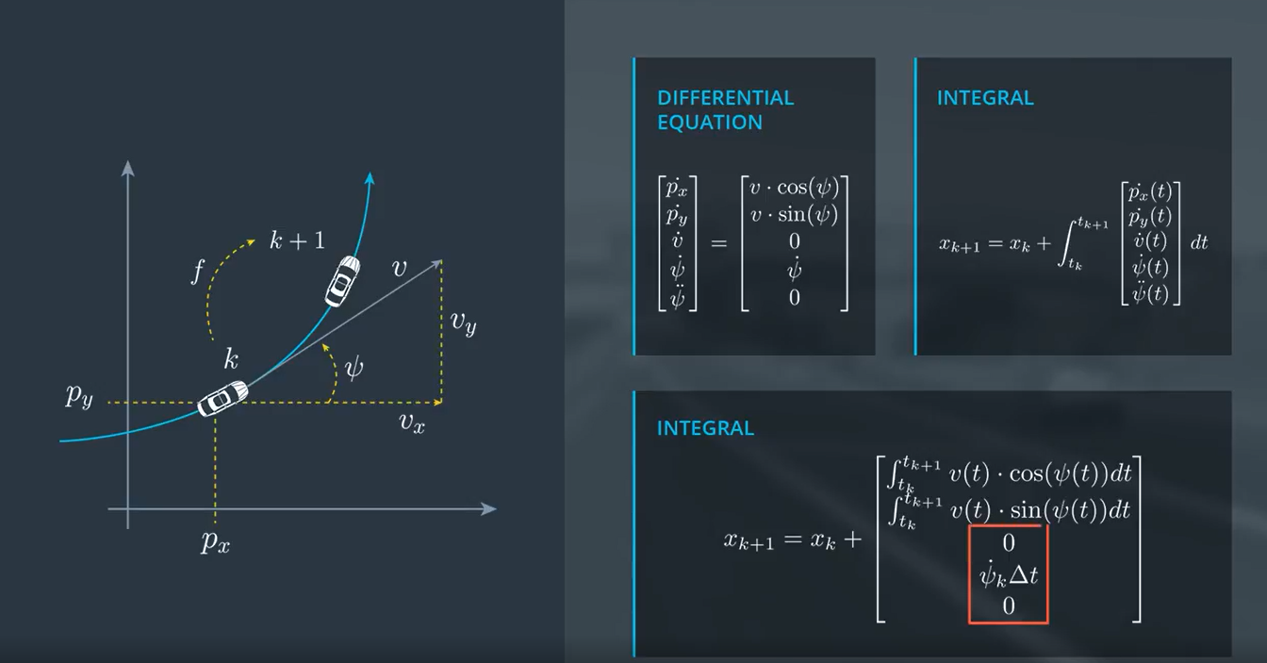
The CTRV Model

Slide 7
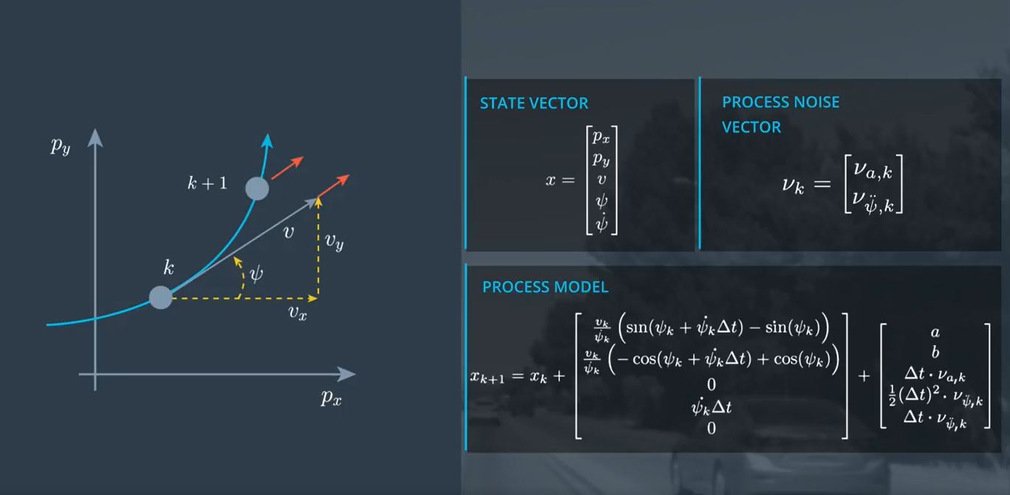
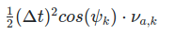
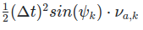
The CTRV Model
a =
b =

Slide 8

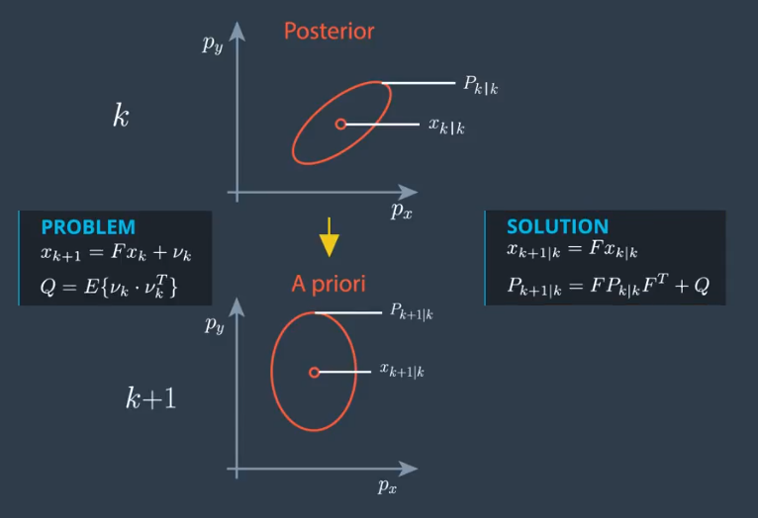
Why Unscented Kalamn Filter

Slide 9
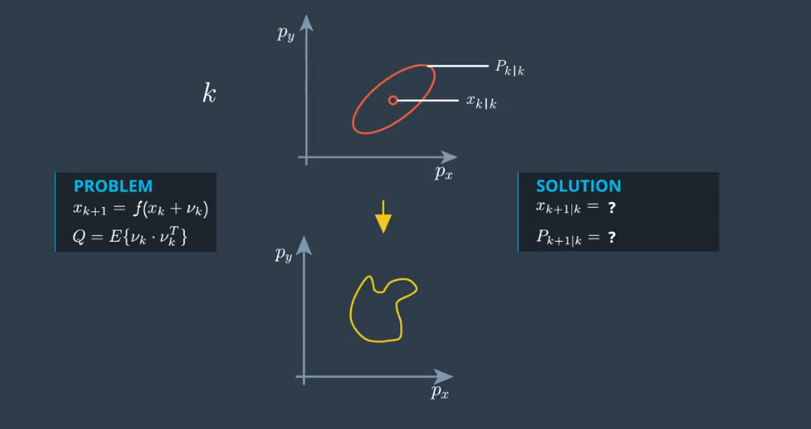

Why Unscented Kalamn Filter

Slide 10
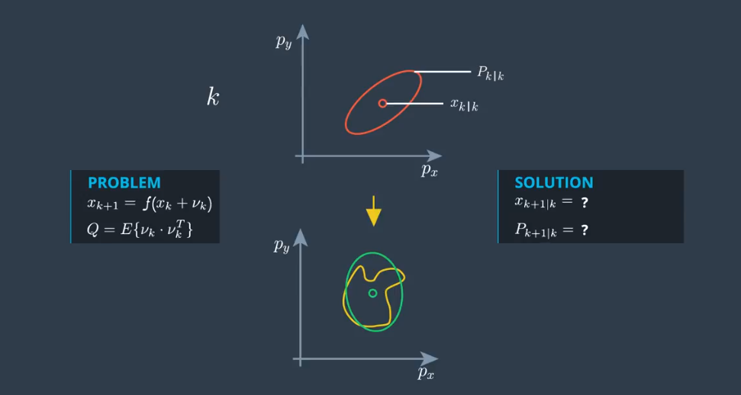

Why Unscented Kalamn Filter

Slide 11

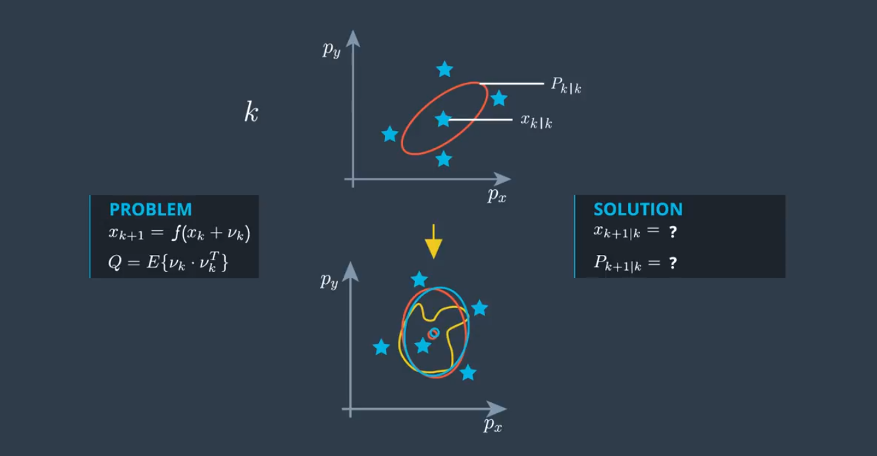
Why Unscented Kalamn Filter

Slide 12
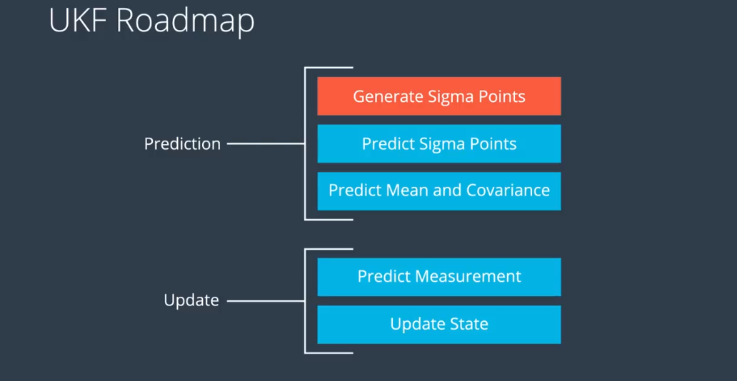

UKF Generate Sigma Points

Slide 13
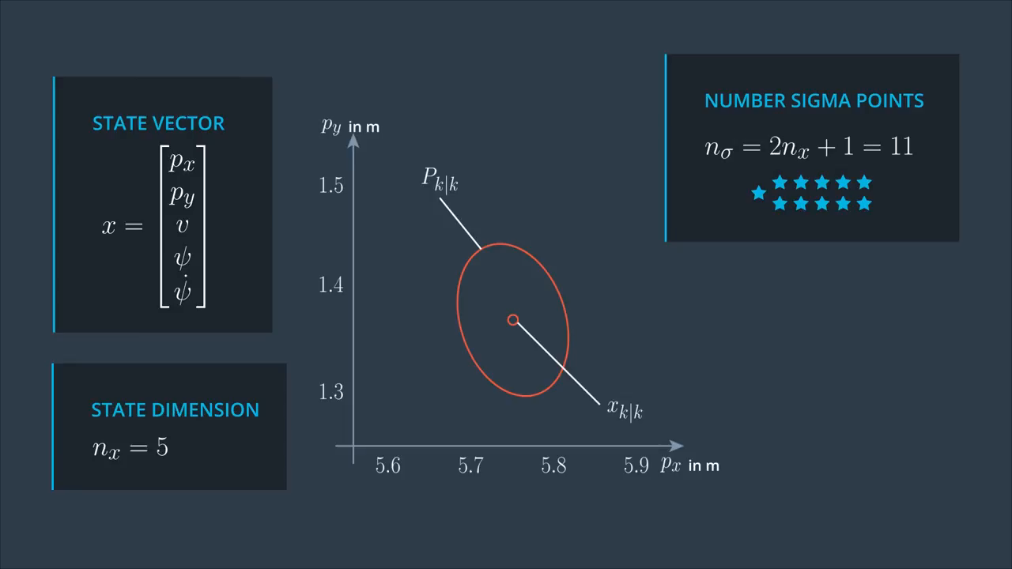
UKF Generate Sigma Points

Slide 14
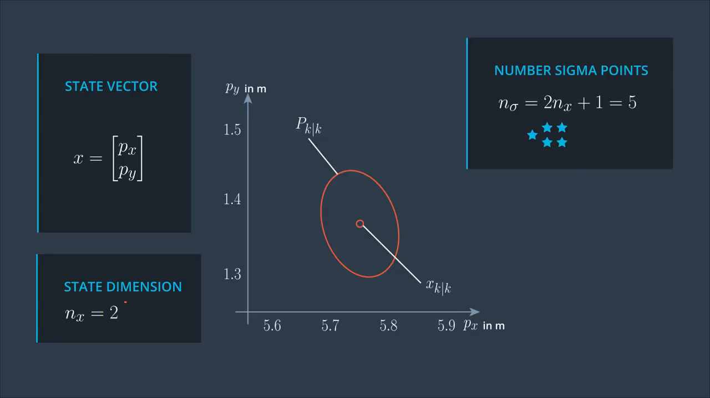
UKF Generate Sigma Points

Slide 15
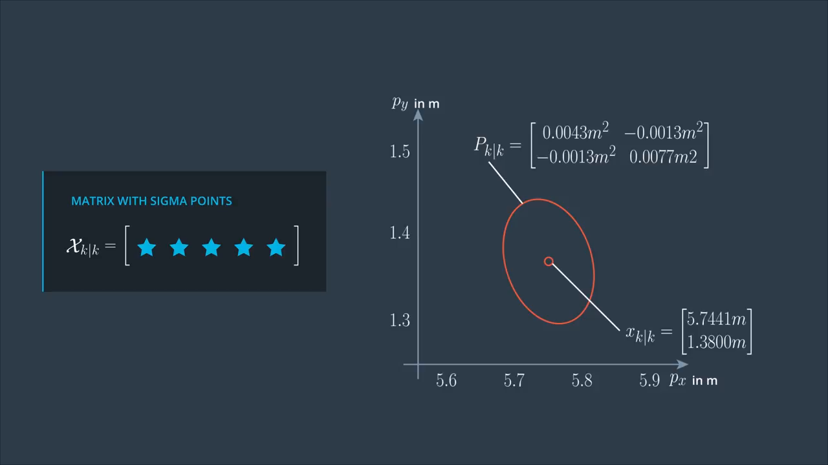
UKF Generate Sigma Points

Slide 16
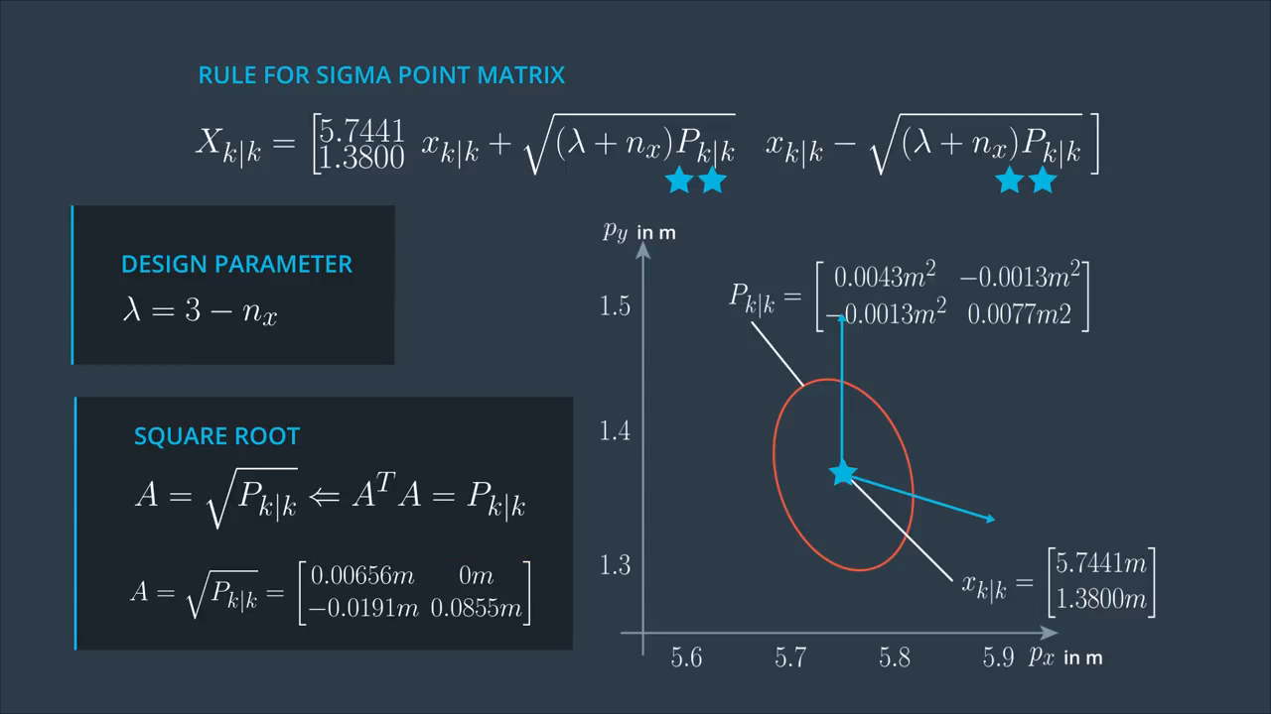
UKF Generate Sigma Points

Slide 17
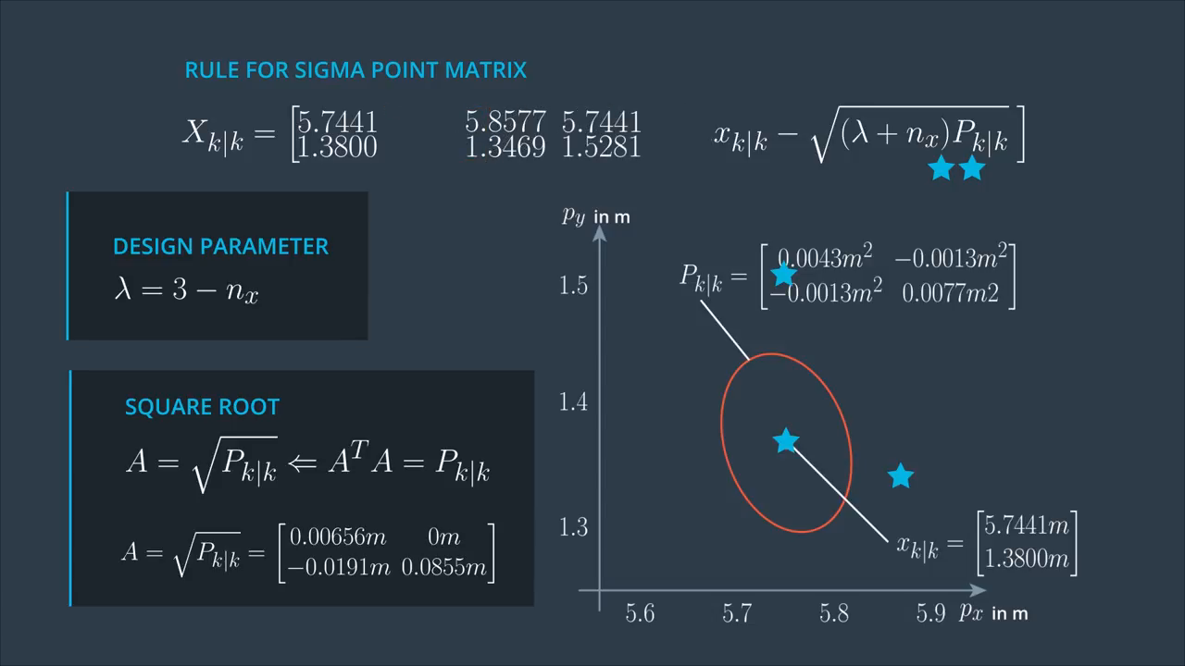
UKF Generate Sigma Points

Slide 18
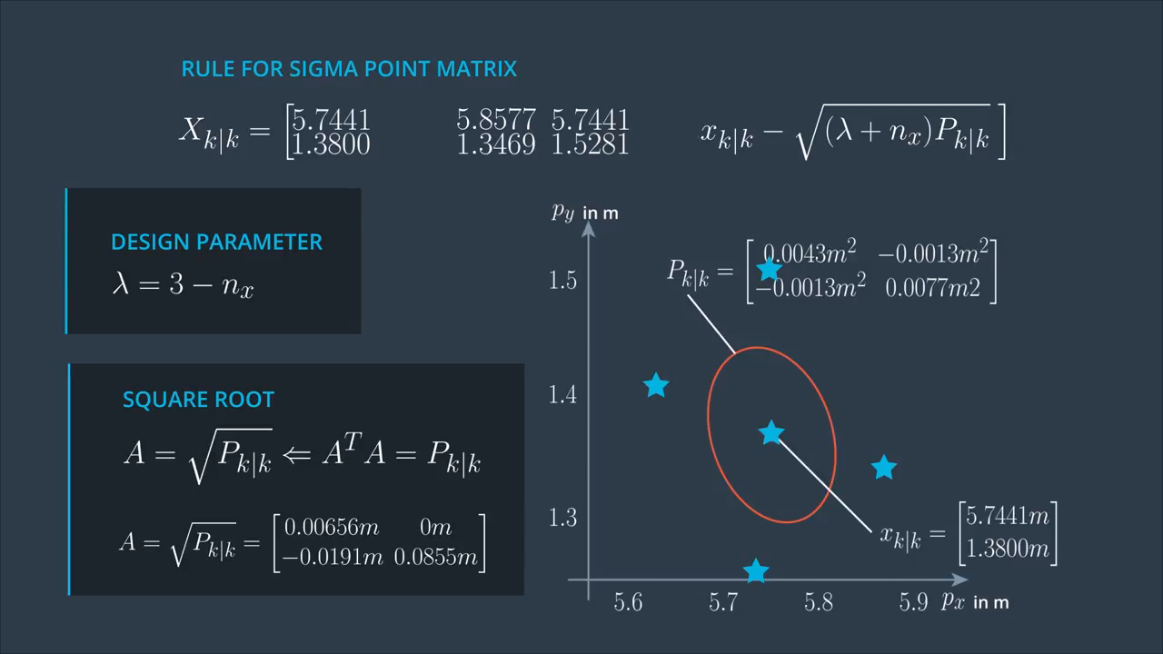
UKF Generate Sigma Points

Slide 19
UKF Generate Sigma Points Code

Slide 20
The CTRV Model
a =
b =

Slide 21
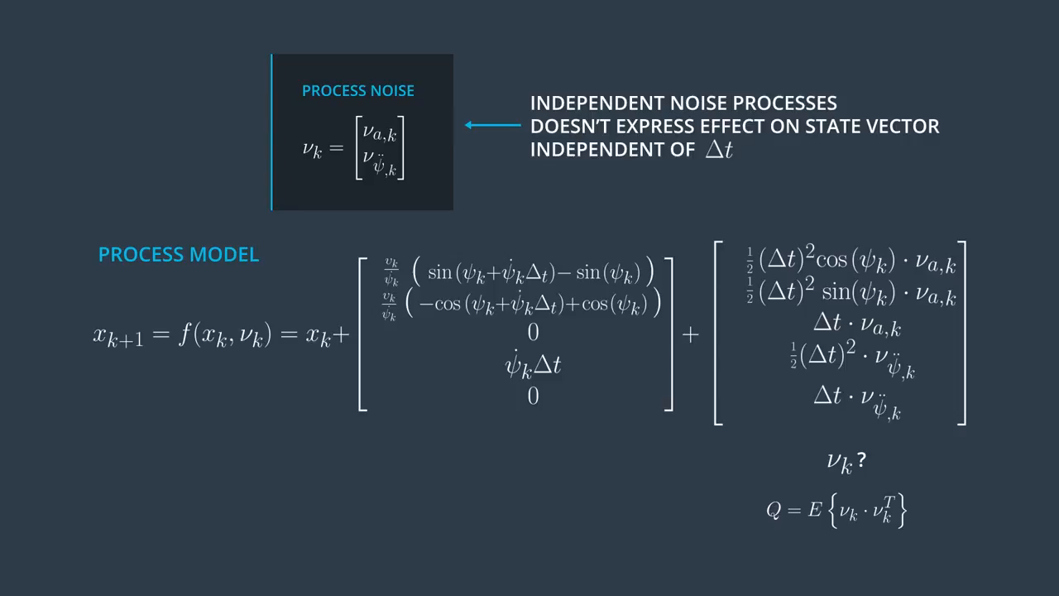
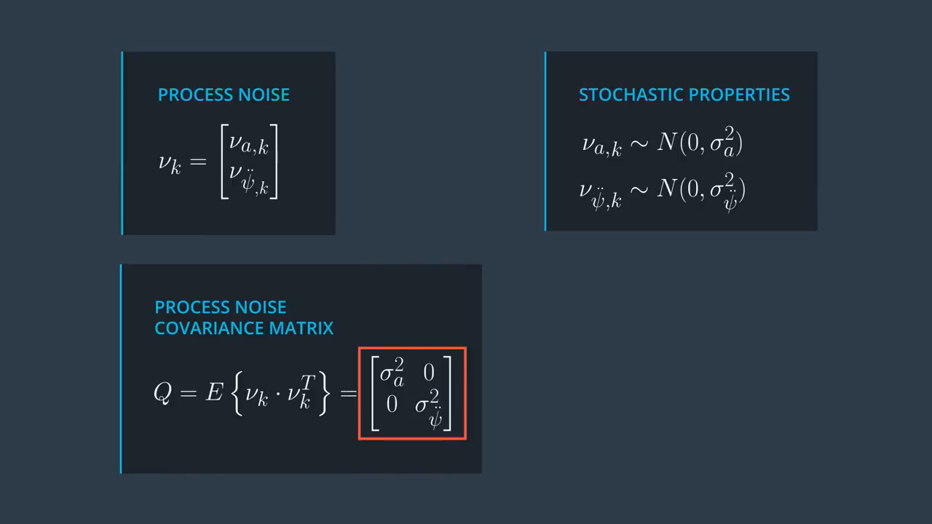
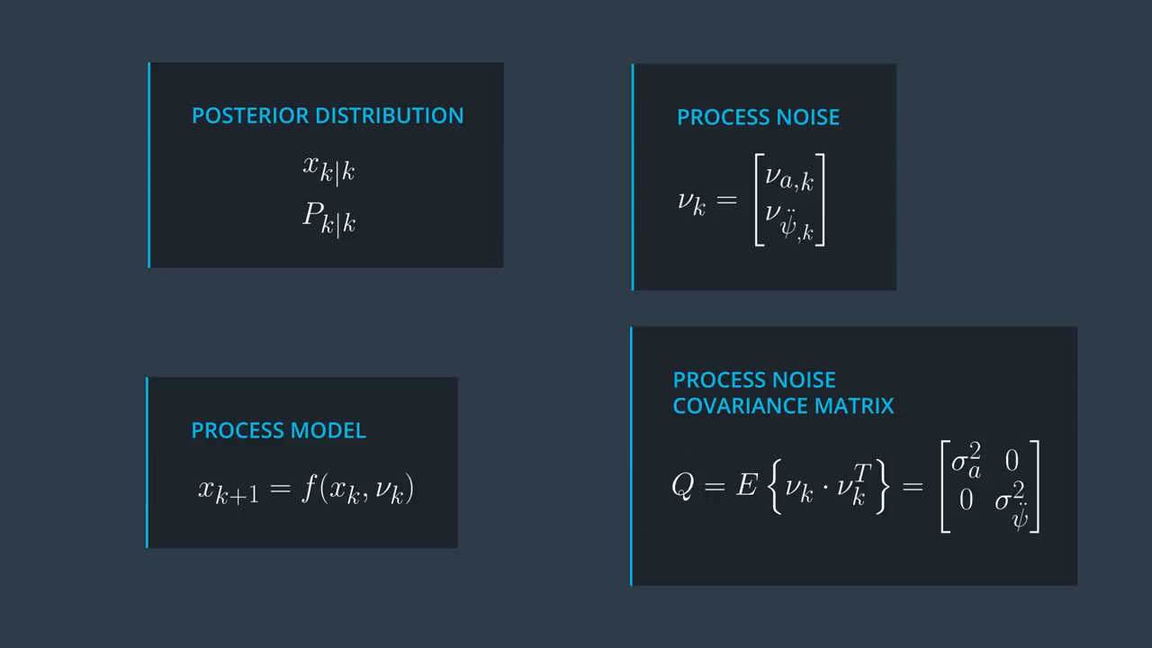
UKF Augmentation

Slide 22
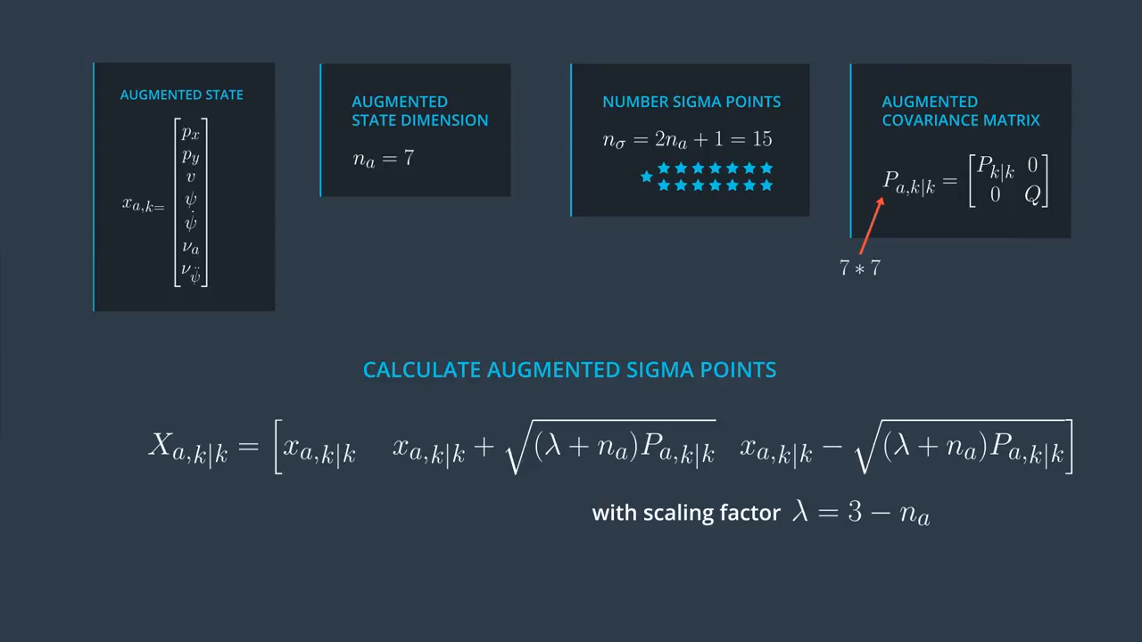
UKF Augmentation
Instead of

Slide 23
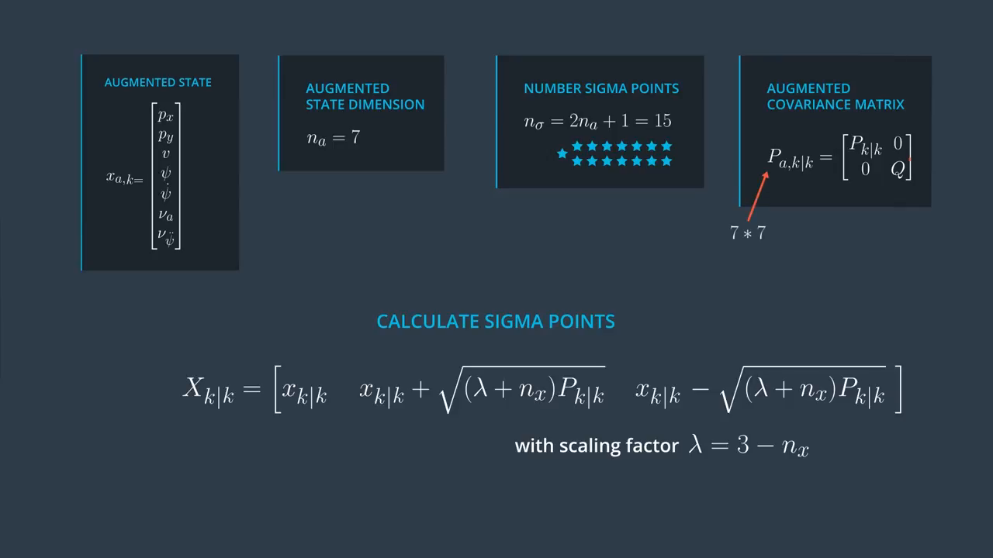
UKF Augmentation

Slide 24
UKF Augmentation Code

Slide 25
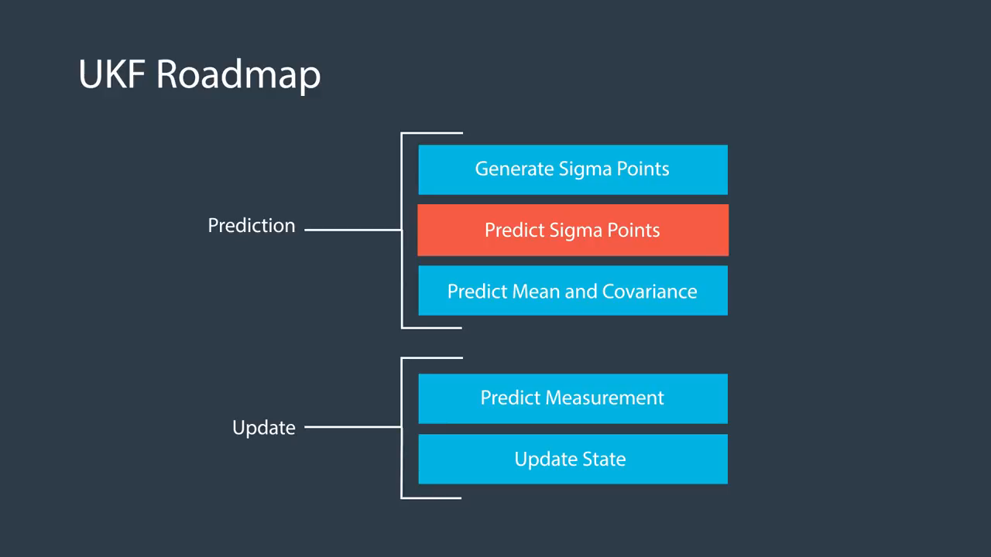
UKF Predict Sigma Points

Slide 26
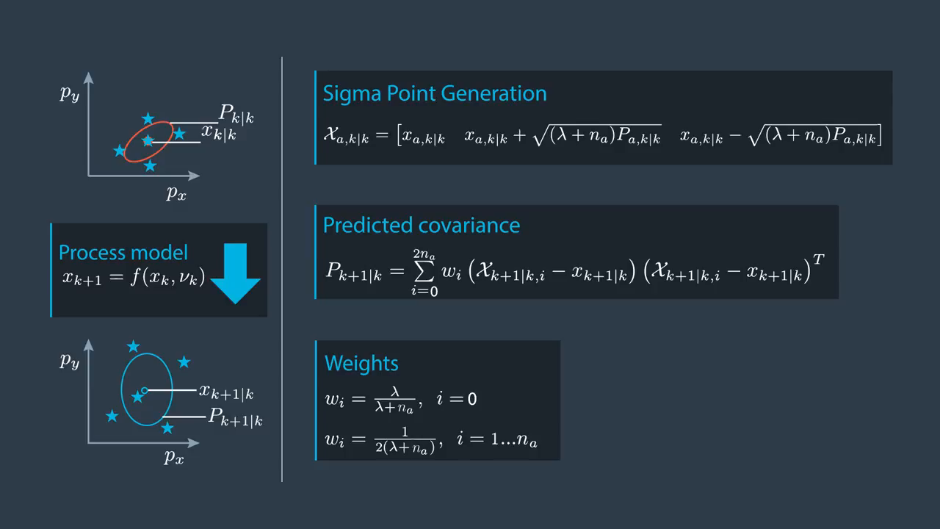
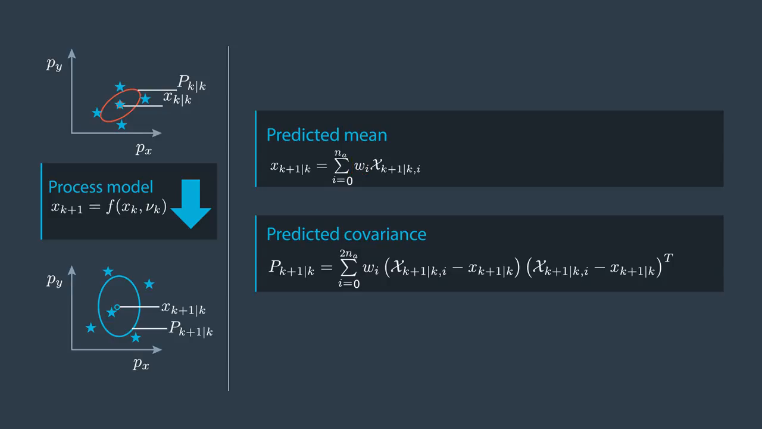
UKF Predict Sigma Points

Slide 27
UKF Predict Sigma Points Code

Slide 28
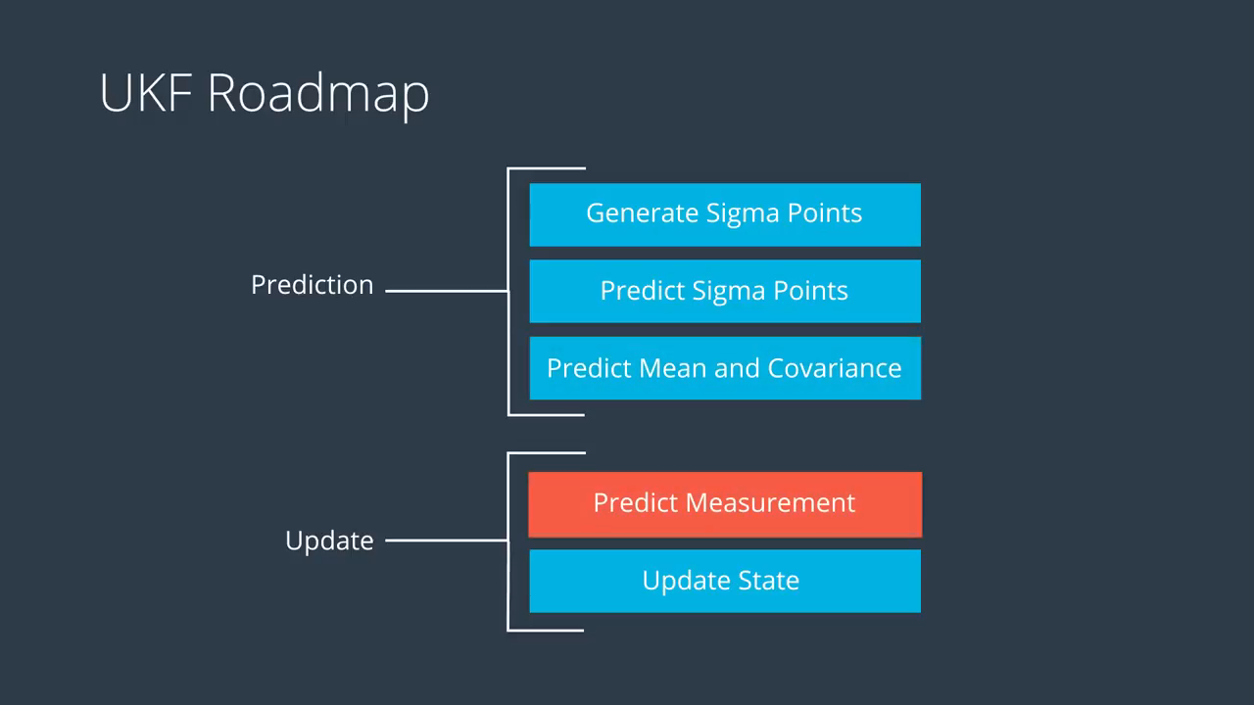
UKF Measurement Prediction

Slide 29
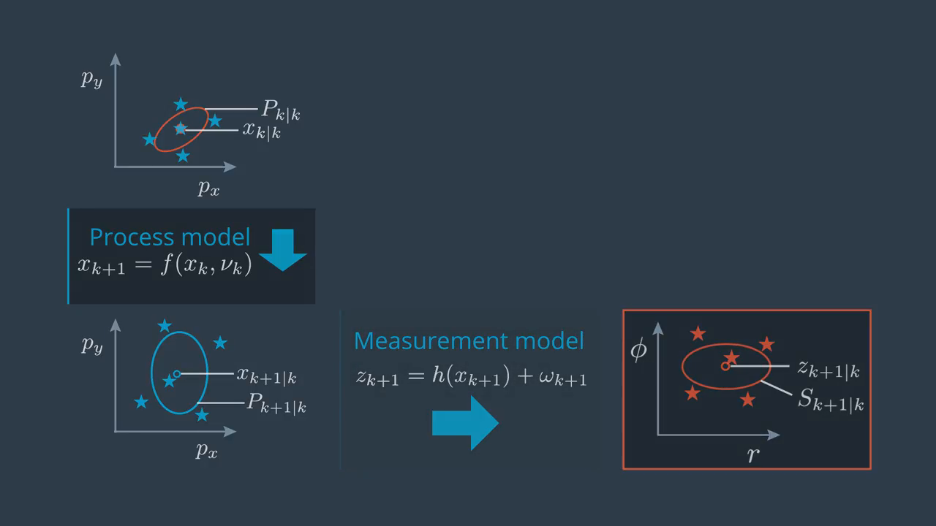
UKF Measurement Prediction

Slide 30
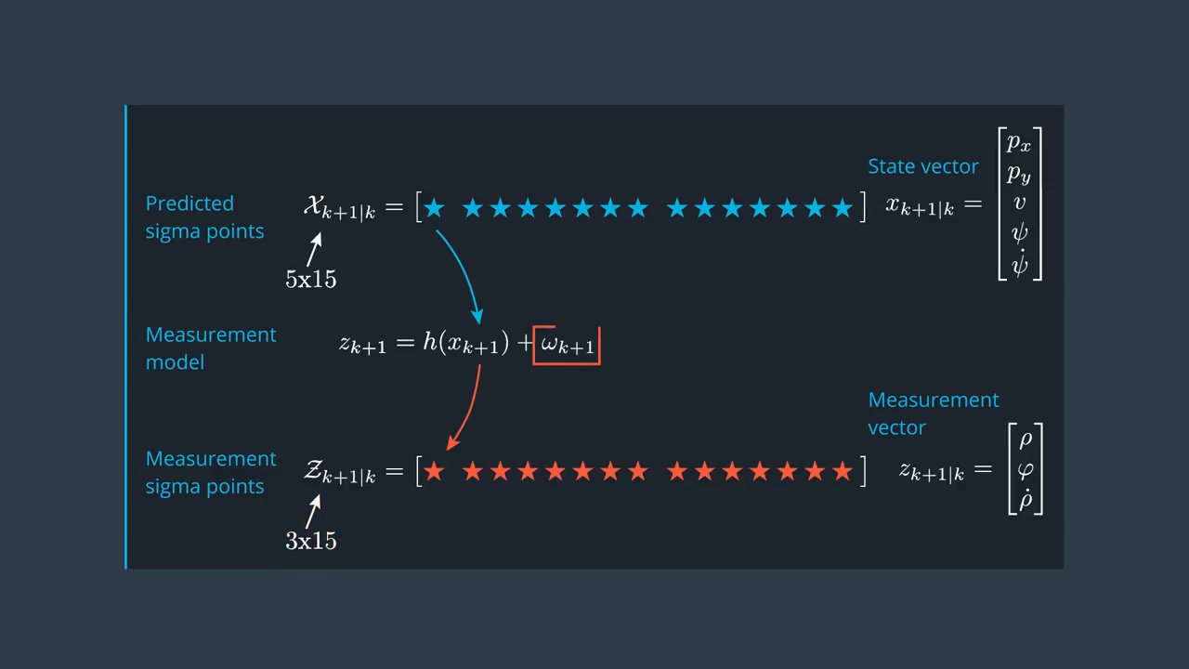
UKF Measurement Prediction

Slide 31
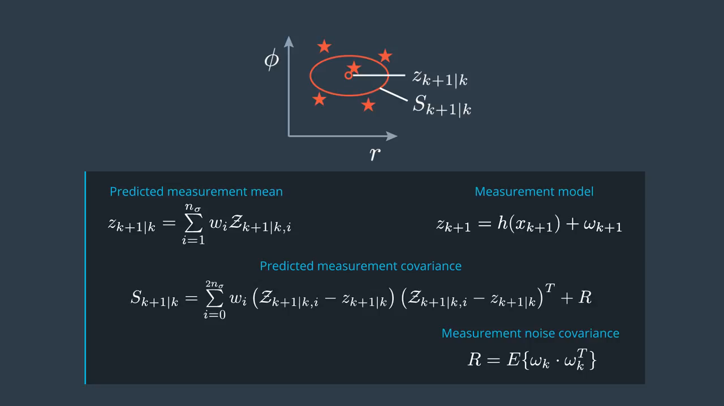

UKF Measurement Prediction

Slide 32
UKF Measurement Prediction Code

Slide 33
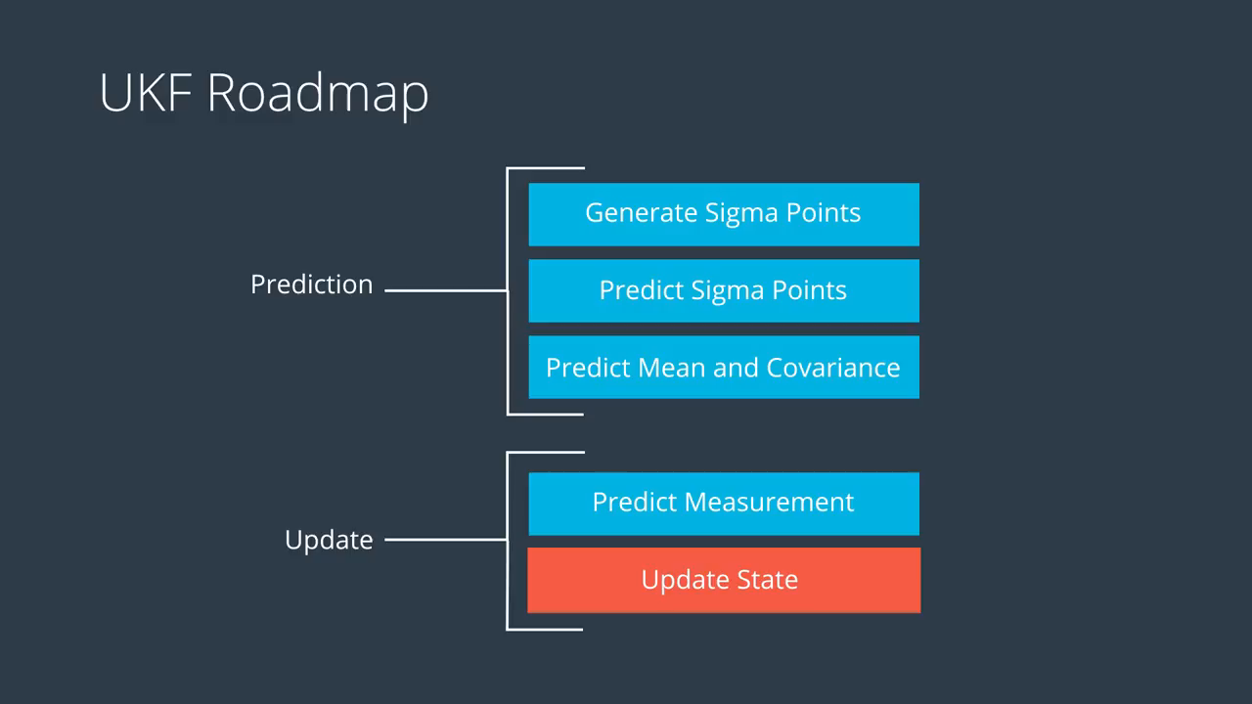
UKF Update

Slide 34
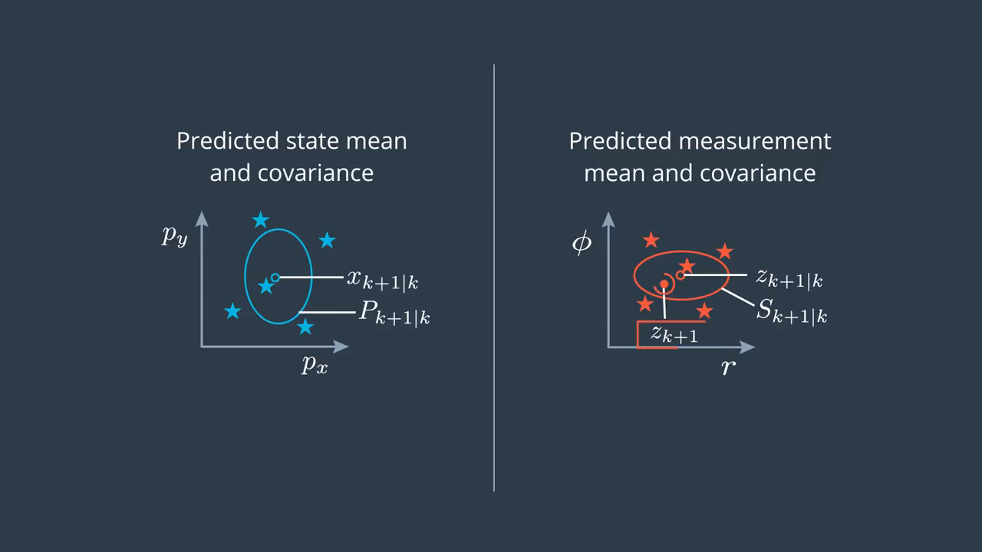
UKF Update

Slide 35
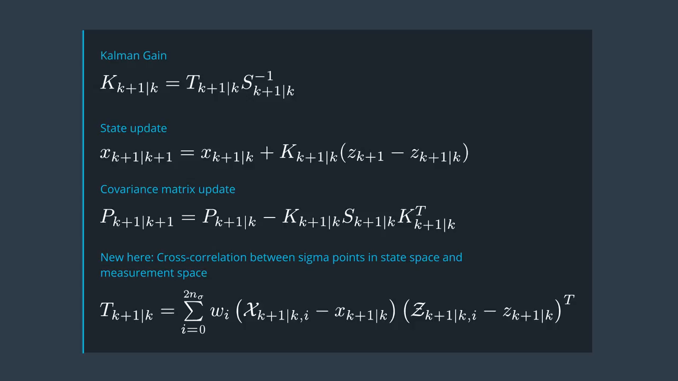
UKF Update

Slide 36
Kalman Filter Equations
Measurement Transformation Matrix
Meas. Vector
State Vector update
state Transformation matrix
Measurement noise Covariance Matrix
Process noise
state Vector
Kalman Gain
Process noise Covariance Matrix
State Covariance Matrix update
State Covariance Matrix

Slide 37
UKF Update Code

Slide 38
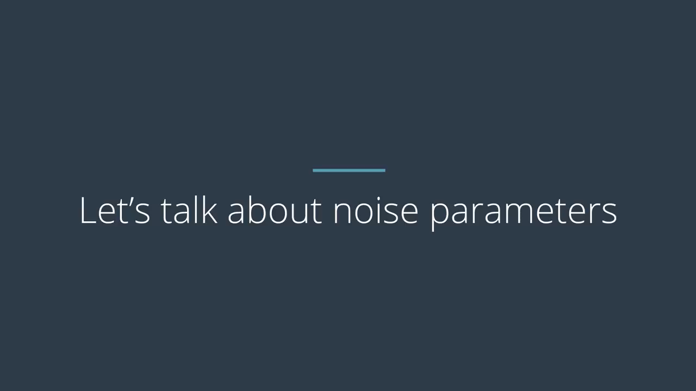
Parameters And Consistency

Slide 39
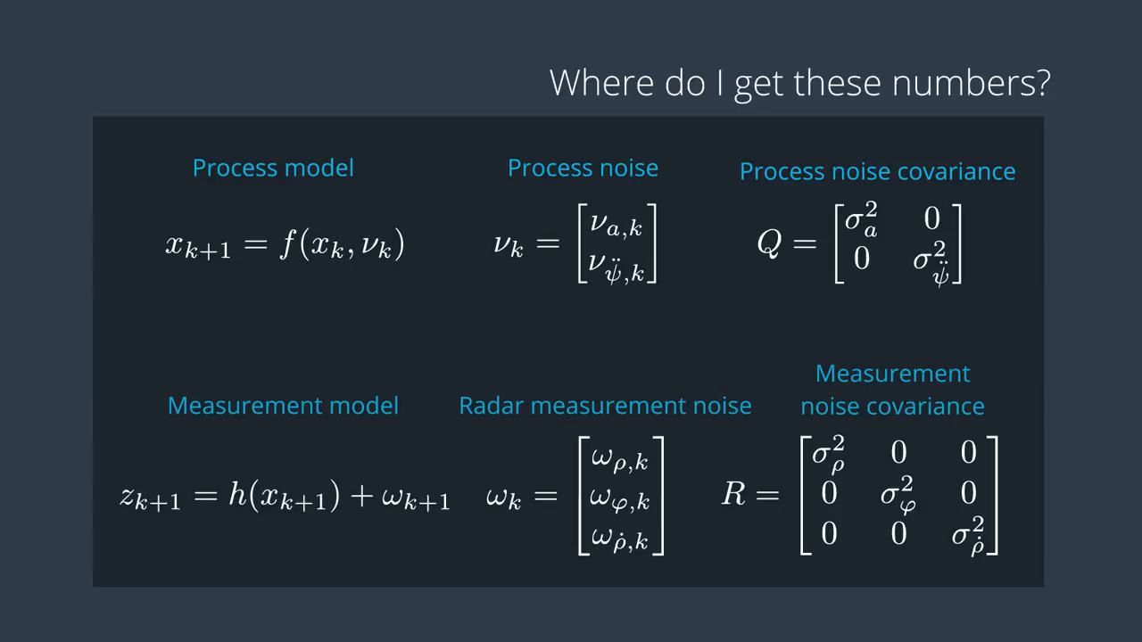
Parameters And Consistency

Slide 40
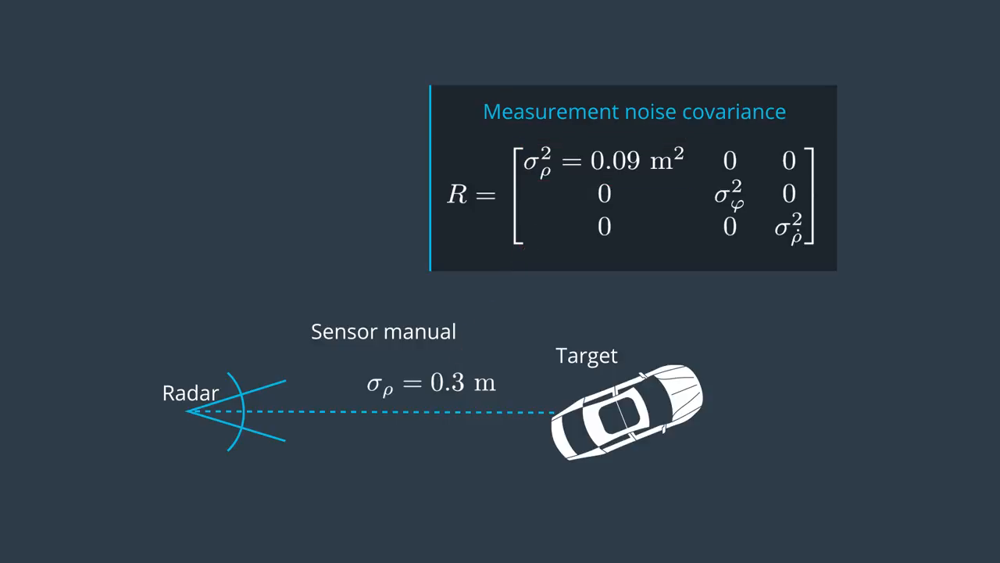
Parameters And Consistency

Slide 41
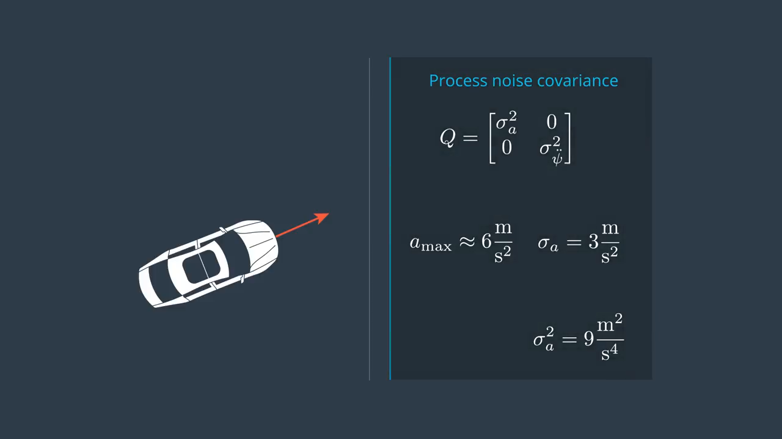
Parameters And Consistency

Slide 42
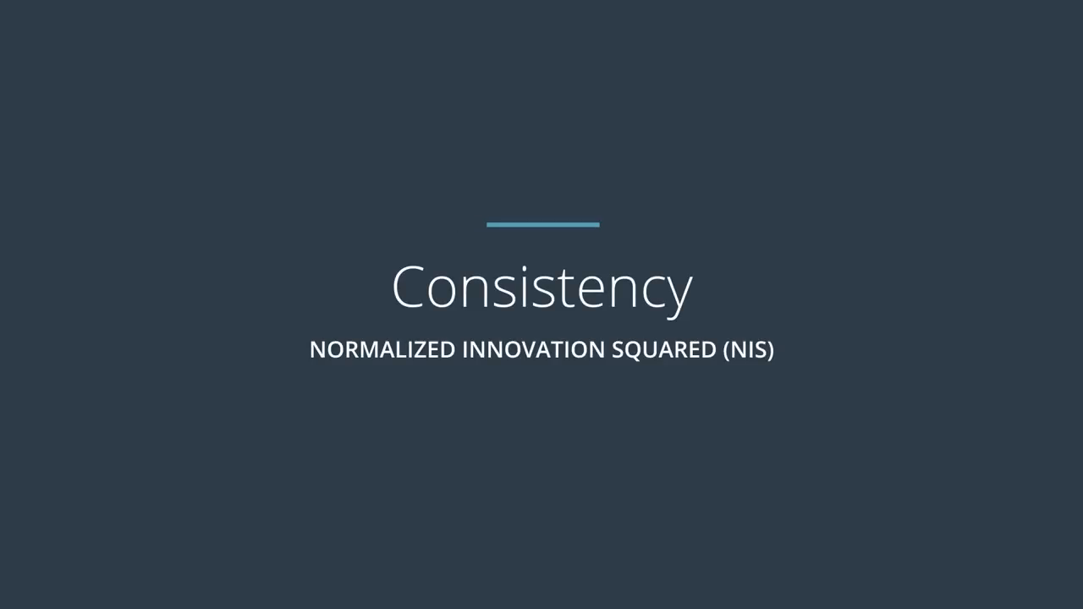
Parameters And Consistency

Slide 43
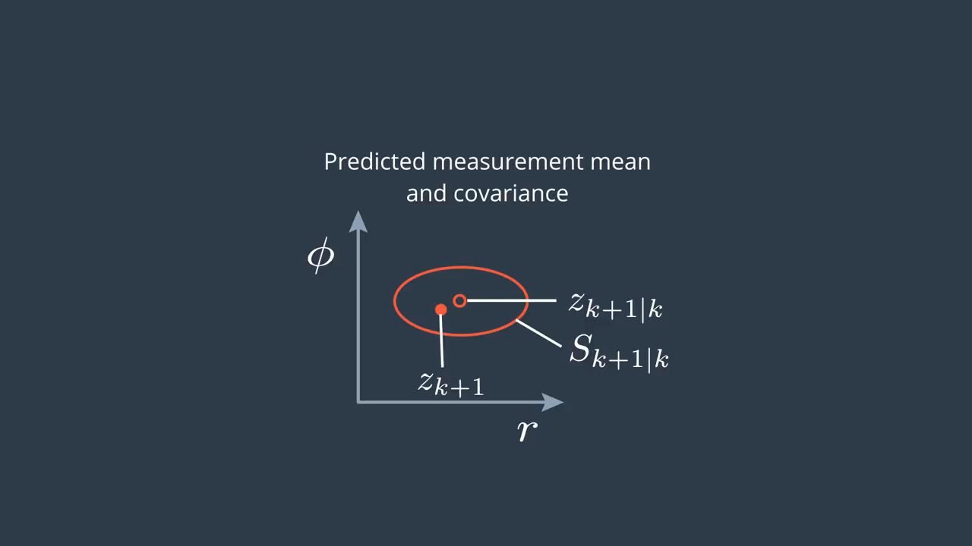
Parameters And Consistency

Slide 44
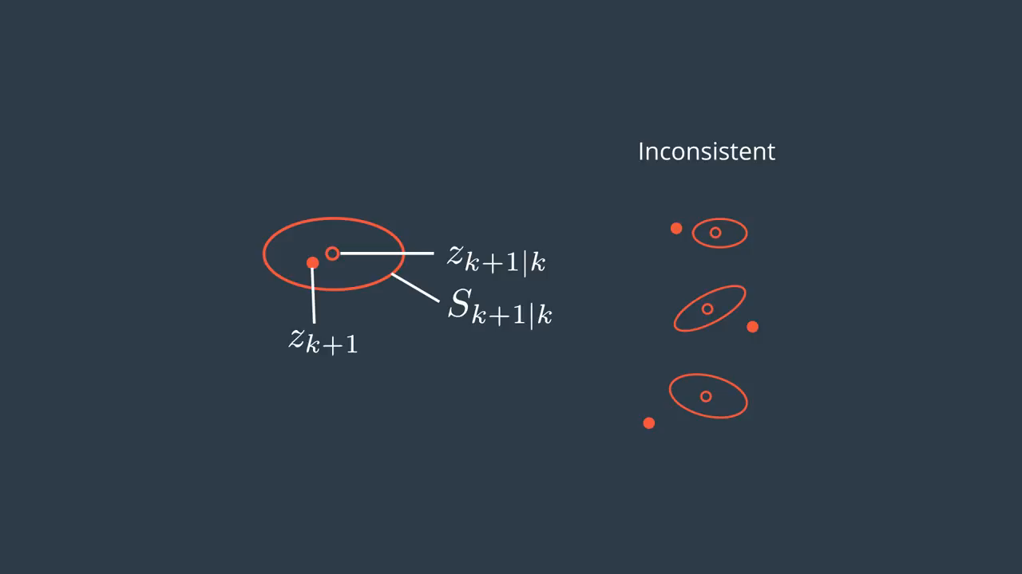
Parameters And Consistency

Slide 45
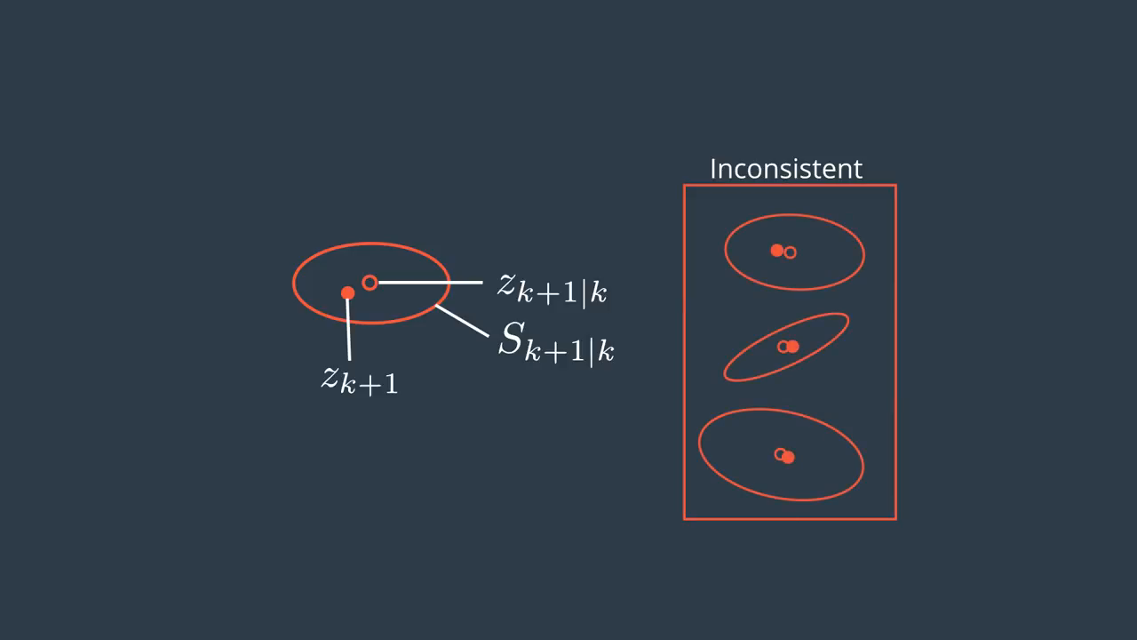
Parameters And Consistency

Slide 46
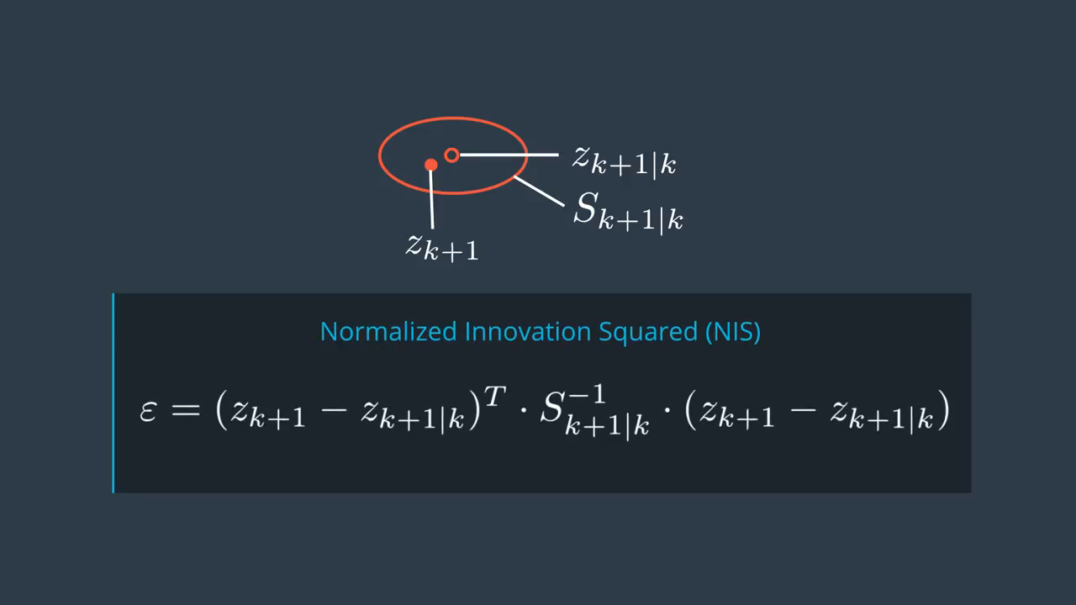
Parameters And Consistency

Slide 47
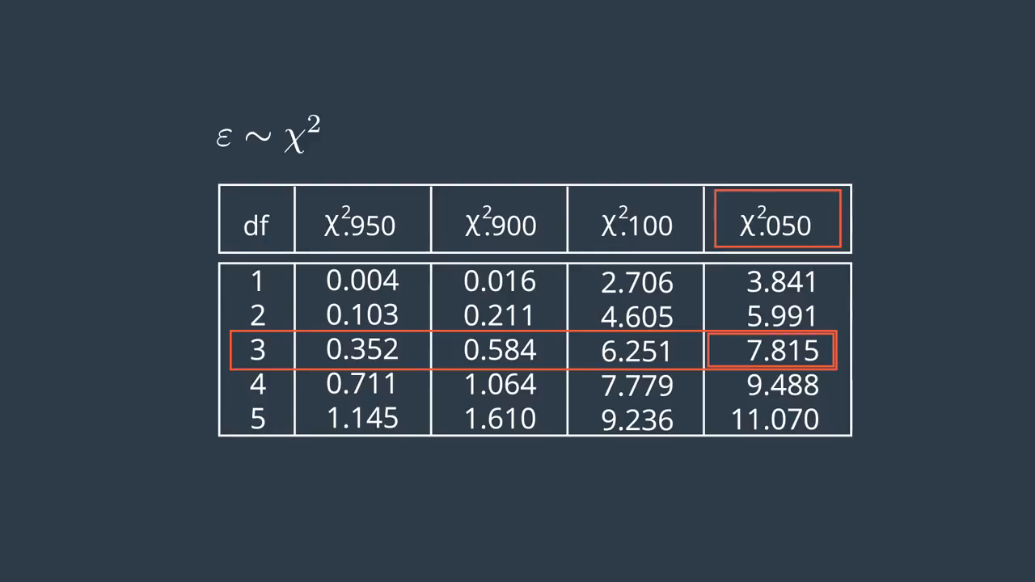
Parameters And Consistency

Slide 48
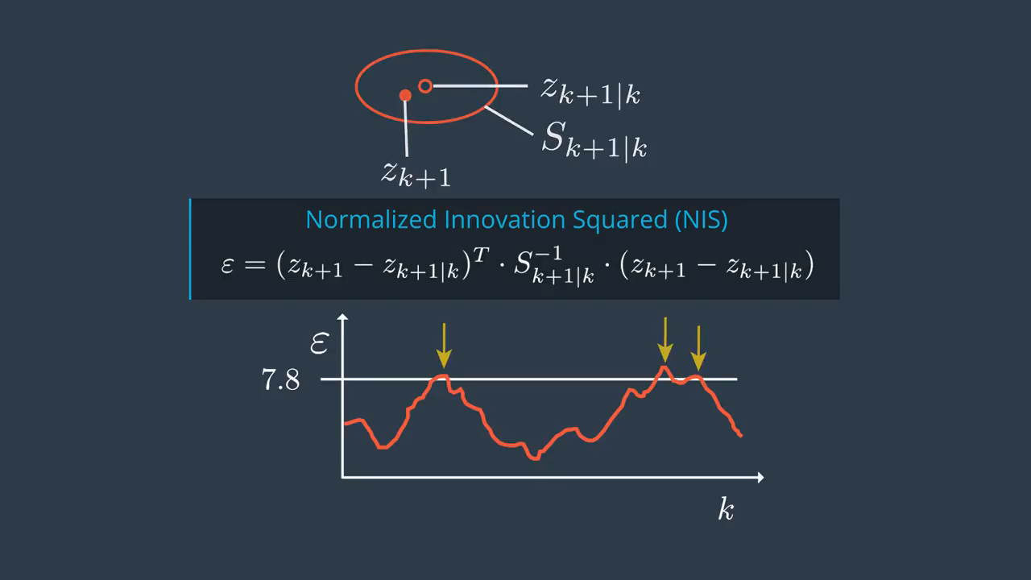
Parameters And Consistency
5% number →

Slide 49
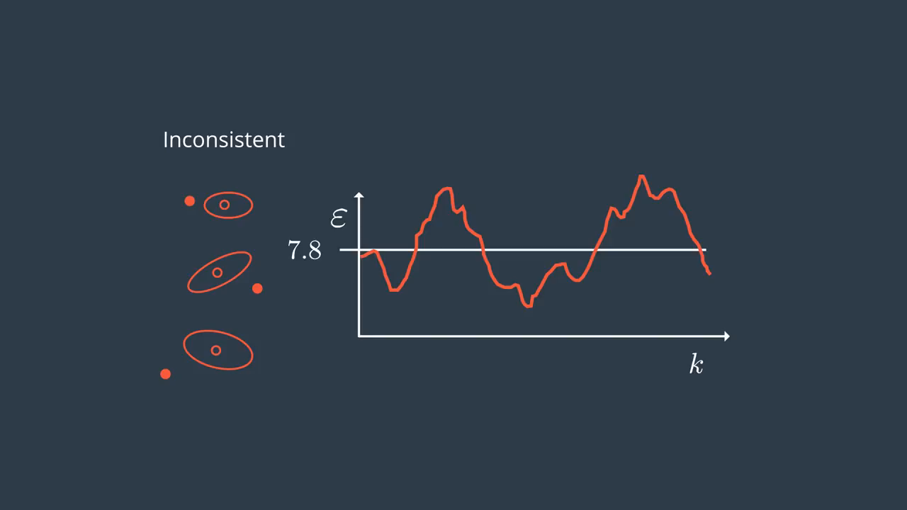
Parameters And Consistency

Slide 50
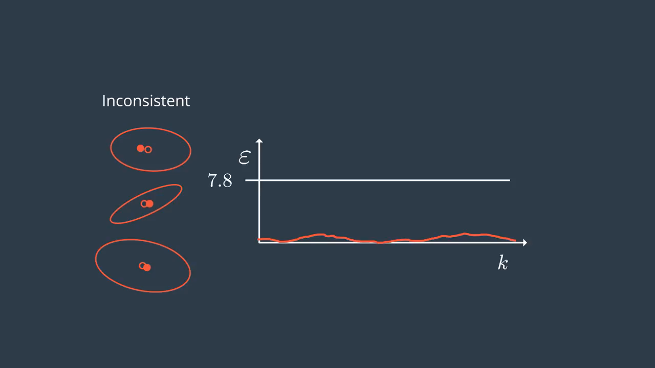
Parameters And Consistency

Slide 51
Unscented Kalman Filter Highway Project

Slide 52


